Slide 1


Minor Project
Title: Student Accommodation Finder System
Presented by:
R214220092 - Aditya Pratap Singh Manral
R214220095 - Aditya Singh
R214220120 - Akshit Rana
R2142201096 -Shivansh Bansal
Mentored By:
Dr. Sonali Vyas
Assistant Professor - Senior Scale
School of Computer Science
University of Petroleum and Energy Studies

Slide 2
Content
Introduction
Literature Review
Objectives
Methodology
Working Model
Results
Conclusion
References

Slide 3
Introduction
With rise in internet facility the need of manual labour has reduced. recommendation systems are much more in use than ever before.
Our recommendation system focuses on recommending best suited hostel for a user on the basis of their choices and preferences.
The recommedation system reduces commuting cost, investment of time and ease of access.
So, to solve this problem which requires a lot of hassle and inconvenience we provide accommodation suggestions to the students via our platform Hostelpedia.

Slide 4
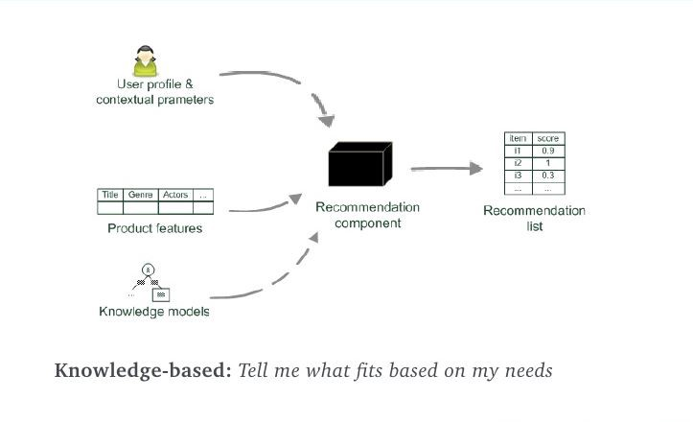
Technical Concepts (Algorithm) used:
Content-based recommendation algorithm
A Content-Based Recommender works by the data that we take from the user, either explicitly (rating) or implicitly (clicking on a link). By the data we create a user profile, which is then used to suggest to the user, as the user provides more input or take more actions on the recommendation, the engine becomes more accurate.
The front-end is supported by HTML, CSS, Javascript for making the user-interface
The back-end is developed in python and reads the data from the provided dataset

Slide 5
Motivation:
To cater the needs of the students for their search of hostel and provide them good platform which contains the information of all the hostels which helps them choose their hostels wisely and precisely.
To reduce human effort and provide the user need at ease
Problem Statement:
Students face problem while searching for a hostel going door to door. This involves time and money consumption.
Our student accommodation finder system is a one-stop solution for this 21st century issue.
HOSTELPEDIA is a user-friendly web-based application that helps to find suitable housing property for students based on user ratings and preferences.

Slide 6
Area of application:
Students who are looking for a hostel can use our application for best suiting hostel.
Parents of respective students can also be user of the application.
University authority and hostel authority also add up to be the users.
Dataset and input format:
The dataset used is inputed via a google form and through communication in the form of csv file and is fed as a datasheet.
Google form link: https://docs.google.com/spreadsheets/d/1s_wiORQV1iqeDO2PEOtoQRvgqtrtzWJ-eJGDqU_ELRo/edit?usp=sharing

Slide 7
Literature Review
Cite Related work:
Chunsheng Cui, Meng Wei, Libin Che, Shouwen Wu & Erwei Wang: Hotel recommendation algorithms based on online reviews and probabilistic linguistic term sets,(2022).https://doi.org/10.1016/j.eswa.2022.118503
Inference from Literature:
In an attempt to review existing literature on this innovation-Hostel Recommendation System, we came across a number of similar products that are in use in many colleges worldwide.
Our platform Hostelpedia when taken into account, removes the manual work of visiting the hostels or their locations thus reducing commuting cost and time. It presents itself as a user-friendly web-application with interactive interface.
It includes prediction, recommendation of accomodations while managing the hostel data at the back-end.

Slide 8
SWOT analysis:
Strengths:
It caters the needs of the students as it is a one-stop destination for searching a suitable hostel according to their needs.
It removes the operating cost of travelling and reduces the time indulgence required.
It is efficient and easy to use system.
Weakness:
It requires a larger dataset for much efficient results.
It requires a dataset containing data from varied geographical locations to present the nearby hostels in that particular geographical locations.
noise in data
Opportunity:
The website can be made more attractive by adding a no of other features
It can be scaled to a commercial level for further business related purpose.
Threat:
Wifi or connectivity issues can be a major problem for operating the application
user-dependency

Slide 9
Objectives
Main Objectives:
Hostel recommendation system aims to solve the problem of freshers to opt the best hostel for his/her living by getting preferences from current members into our website.
We filter all the data from the datasheet with the help of machine learning algorithm called Content-Based Recommendation System by which the user is provided with the best suitable hostel in the terms of distance, Price, vulnerability and comfort.
Sub Objectives:
It operates to reduce the manual labour and the operating cost of money and time.
It provides simple and efficient way of catering the needs virtually than investing time and efforts in manual door-to-door searching.

Slide 10
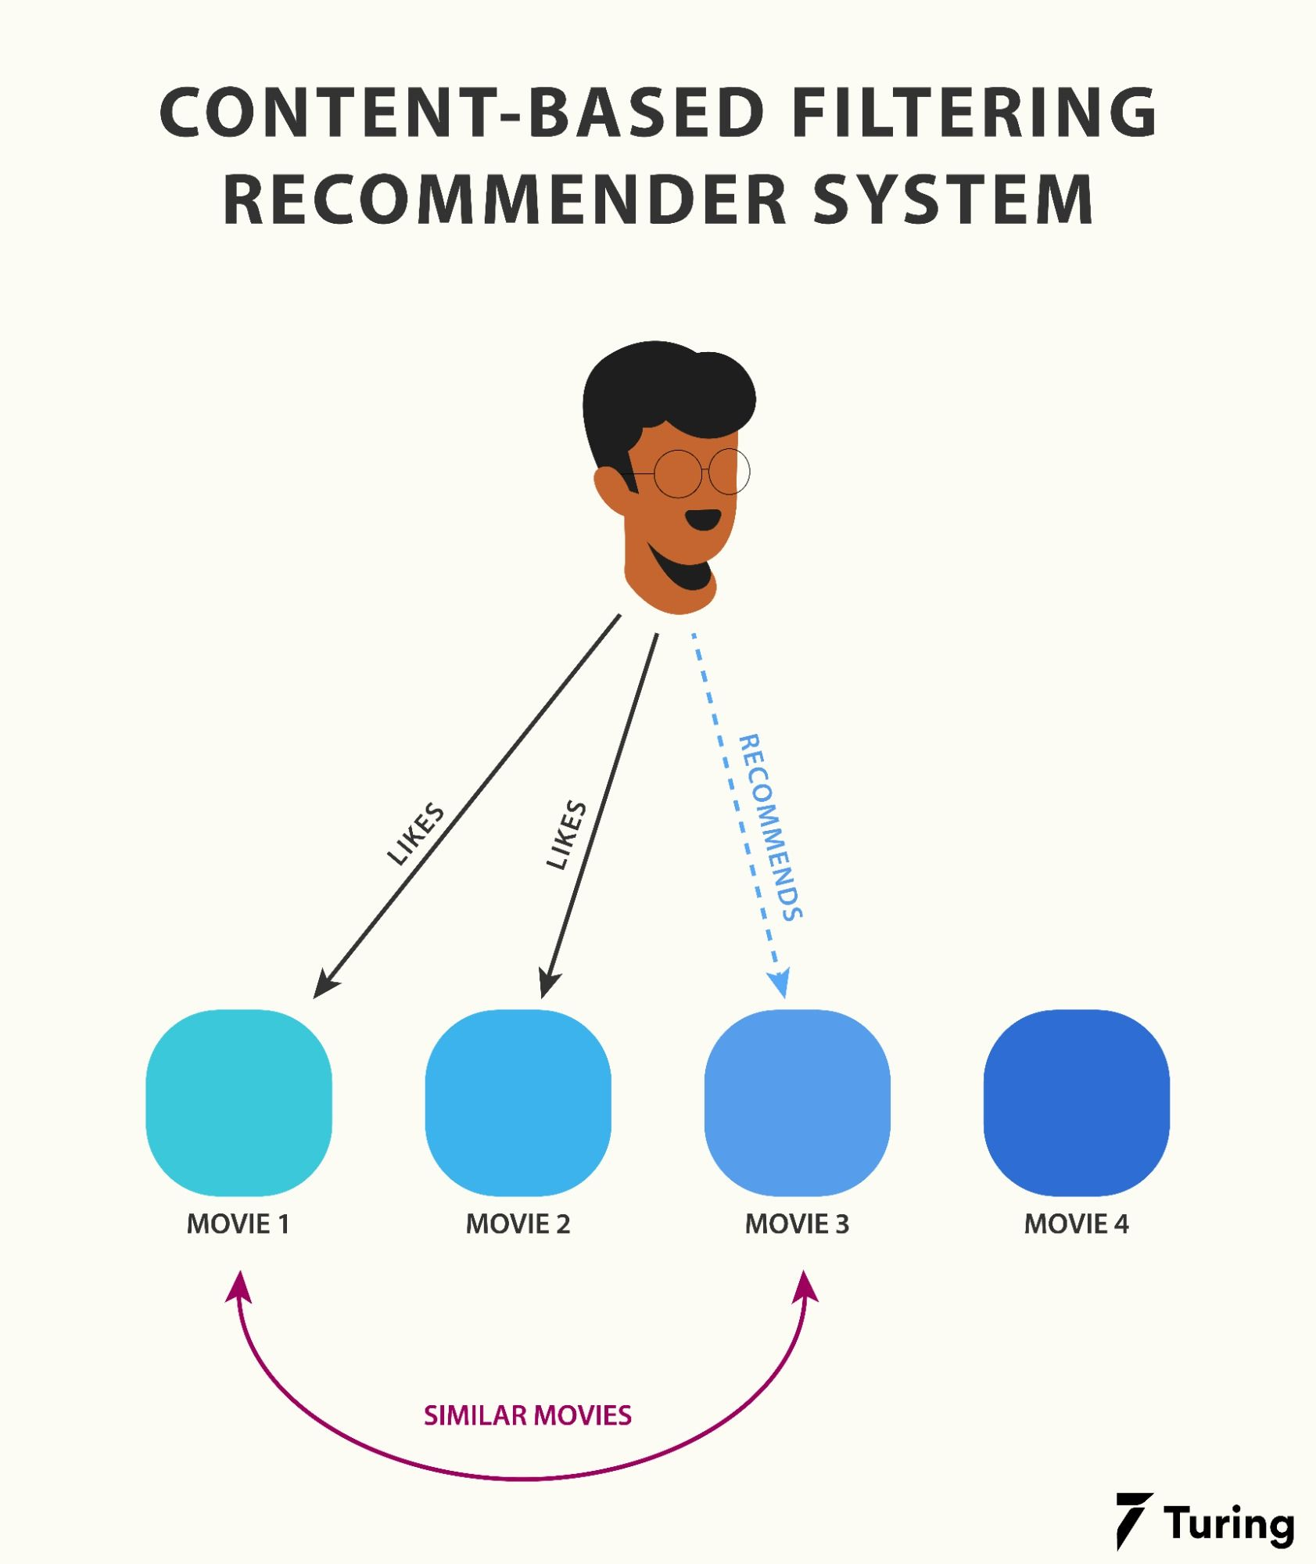
Methodology
Steps:
A Content-Based Recommender works by the data that we take from the user, either explicitly (rating) or implicitly (clicking on a link).
By the data we create a user profile, which is then used to suggest to the user, as the user provides more input or take more actions on the recommendation, the engine becomes more accurate.

Slide 11
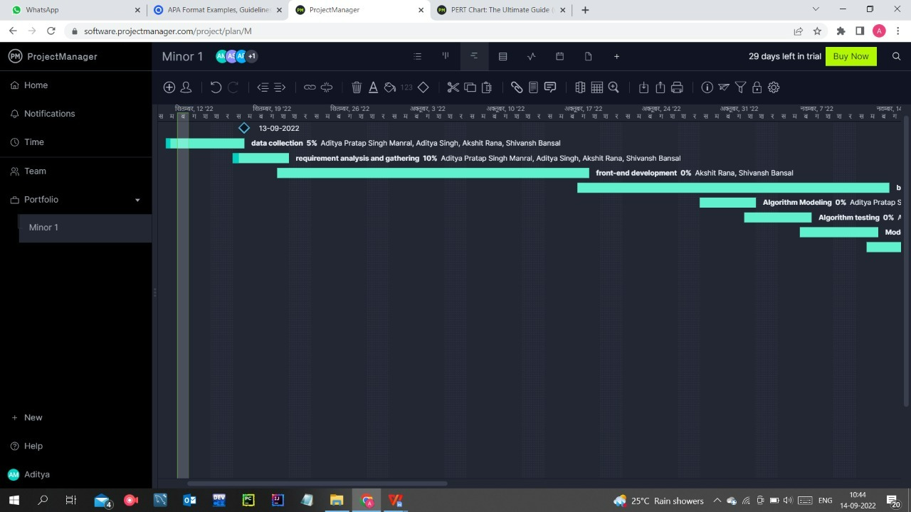
Timeline:

Slide 12
Deliverable of each steps or phase:
The data collection phase includes the data-set for our model. It was collected via a google form and via real-time face-to-face data collection technnique.
The requirement analysis and gathering phase included the feasability check and study of design constraints.
The front-end modelling includes the different web pages which comprises of the GUI of the application. The user-interface works on localhost and provides relevant features and information regarding the web application.
Algorithm modelling includes the designing of the algorithm used for the prediction purpose, i.e. Content-based Recommendation algorithm.
The back-end inlcudes the algorithm which is used for prediction and recommendation and fetches the data from the given datasheet.

Slide 13
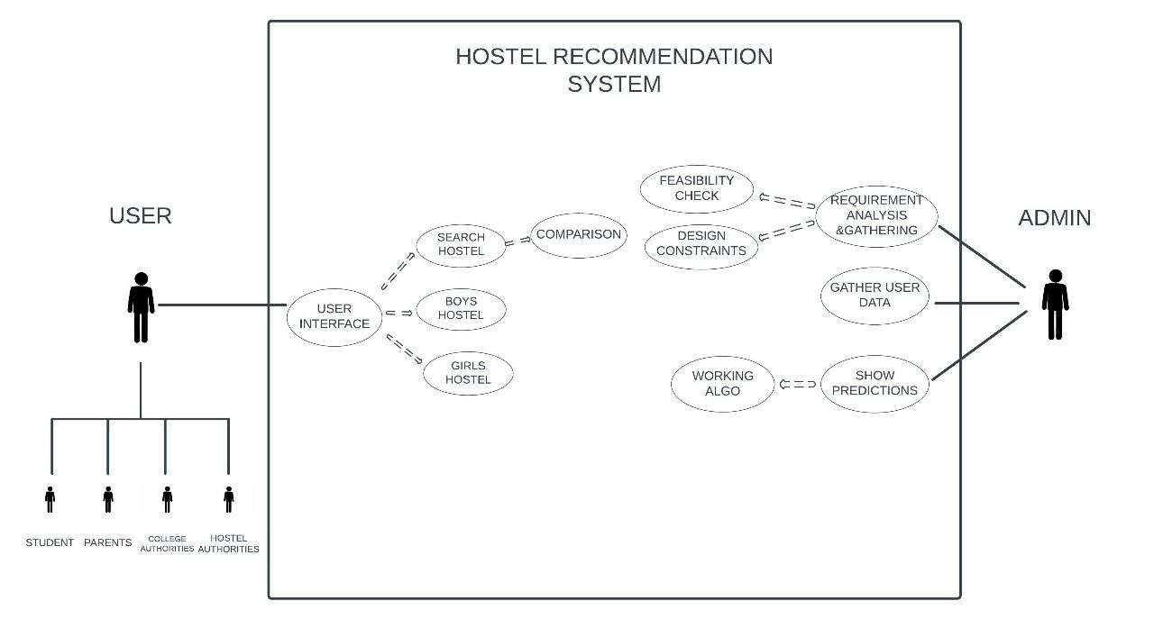
Working Model
Requirement analysis (Link of SRS):
https://drive.google.com/file/d/1ESpFG2EYBXa4vEUTUDbS3lhv5eSzlQLW/view?usp=share_link
Technical Diagram:

Slide 14
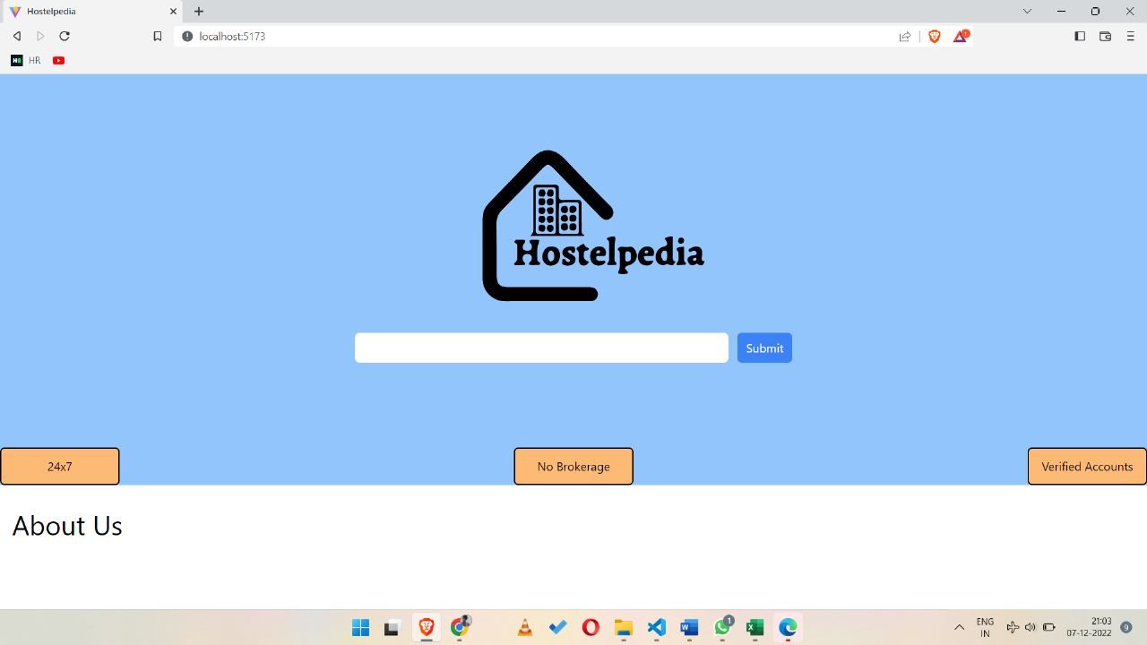
Working Module:

Slide 15
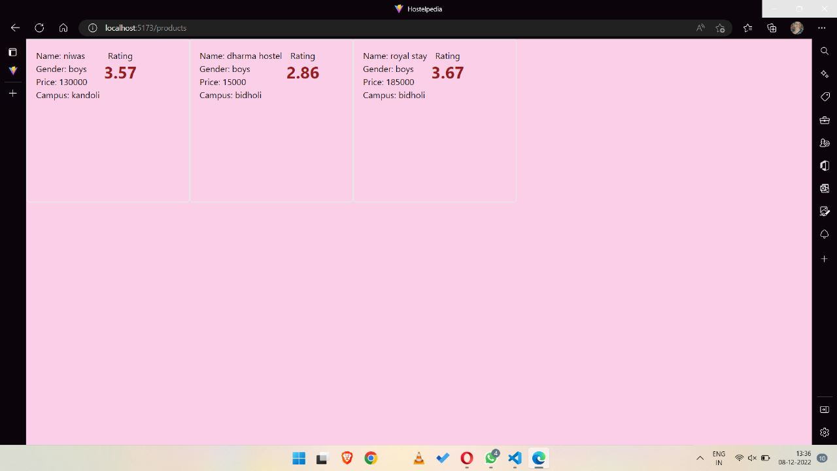
Attained Deliverable:

Slide 16
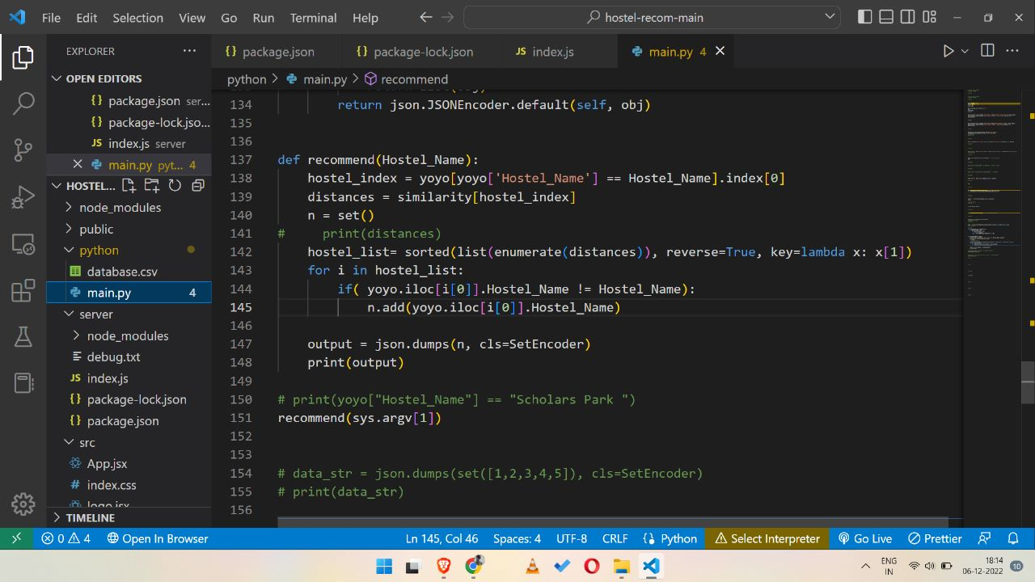
Results:
Test Cases:

Slide 17
Comparative Study:
Chunsheng Cui, Meng Wei, Libin Che, Shouwen Wu & Erwei Wang: Hotel recommendation algorithms based on online reviews and probabilistic linguistic term sets,(2022).https://doi.org/10.1016/j.eswa.2022.118503

Slide 18
Conclusion:
Recommender systems such as content-based filtering benefit both sellers and buyers or users and developers.
They cater to the need of processing a large amount of data present online and produce efficient output. hostel recommendation system tends to be an easy pathway for searching an accommodation via a supportive application.
Justification of objectives:
Our recommender system helps in providing ease of access via its platform
Searching on our platform reduces the usage of commuting money and time investment
Minimizes the human intervention while looking for a suitable accommodation

Slide 19
References
1)Bollacker, K.D., Lawrence, S., Giles, C.L.: CiteSeer: an autonomous web agent for automatic retrieval and identification of interesting publications. In: Proceedings of the 2nd international conference on Autonomous agents, pp. 116–123 (1998)
2)Google Scholar, Scholar Update: Making New Connections,Google Scholar Blog. http://googlescholar.blogspot.de/2012/08/scholar-updates-making-new-connections.html
3)Airoldi, E.M., Blei, D.M., Fienberg, S.E., Xing, E.P., Jaakkola,T.: Mixed membership stochastic block models for relational data with application to protein–protein interactions. In: Proceedings of the International Biometrics Society Annual Meeting, pp. 1–34(2006)
4)Arnold, A., Cohen, W.W.: Information extraction as link predic-tion: using curated citation networks to improve gene detection. In: Proceedings of the 4th International Conference on Wireless Algorithms, Systems, and Applications, pp. 541–550 (2009)
5)Beel, J., Langer, S., Genzmehr, M.: Sponsored vs. Organic (Research Paper) Recommendations and the Impact of Labeling.In: Proceedings of the 17th International Conference on The-ory and Practice of Digital Libraries (TPDL 2013), pp. 395–399(2013)

Slide 20
Thank You

